Slide 1
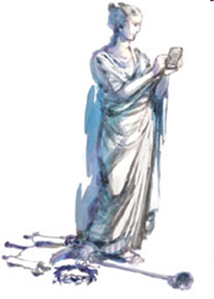
The Zigs and Zags of Human Evolutionary History
Peter Turchin
University of Connecticut and
Complexity Science Hub-Vienna
Clio
Seshat

Slide 3
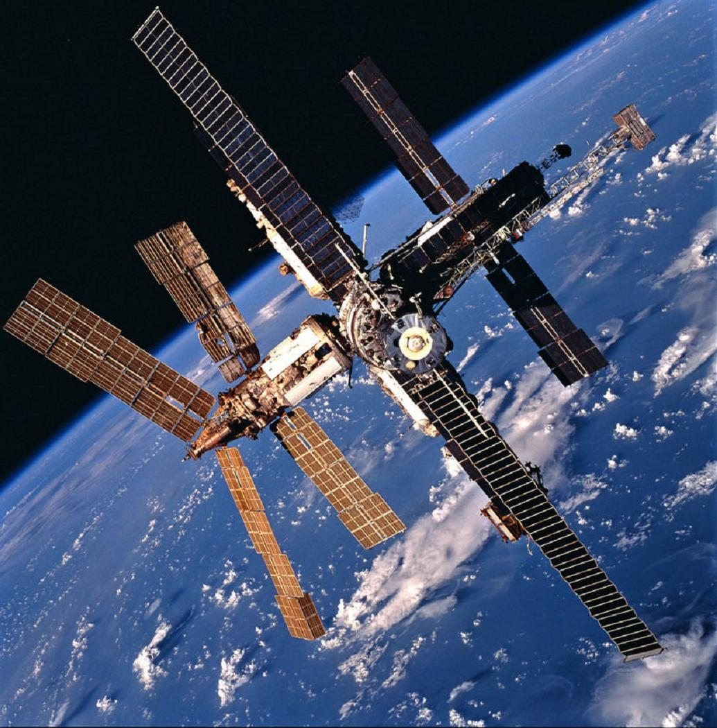
International Space Station
Built by Roscosmos, NASA, ESA, JAXA, CSA
Cost: $150 bln
3 mln people-years
>1 bln citizens in participating countries
Humans are capable of cooperating in huge groups of strangers
Notes:
3

Slide 4
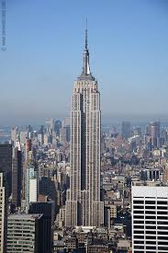
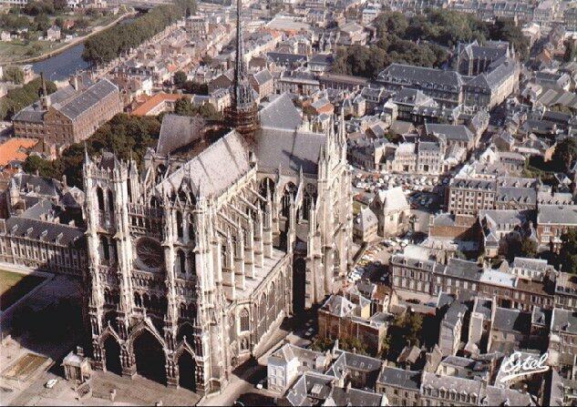
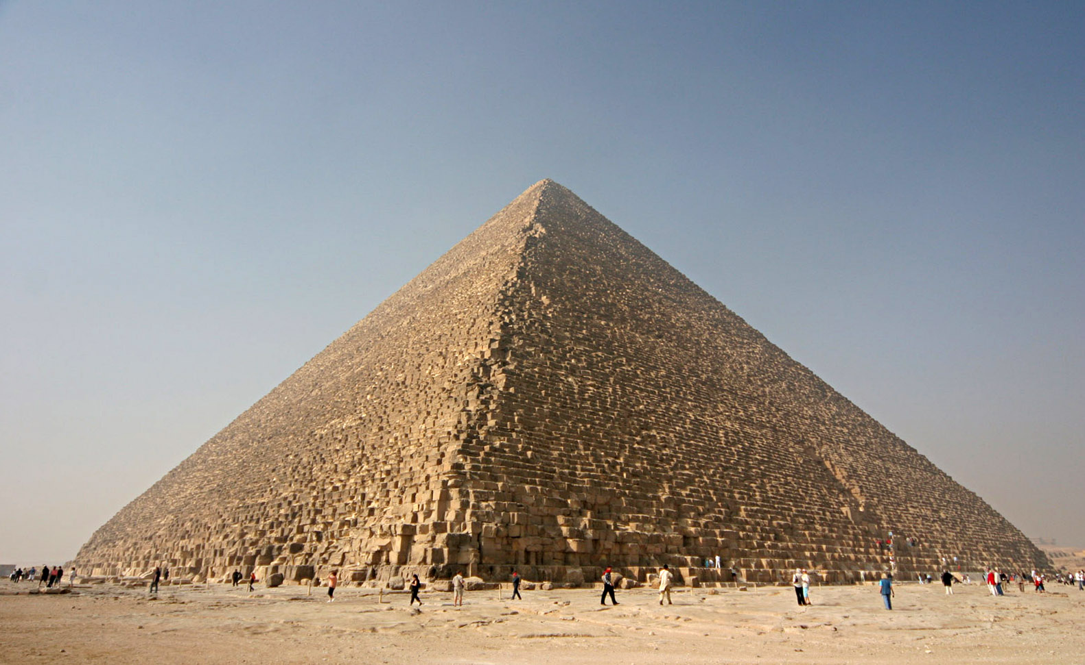
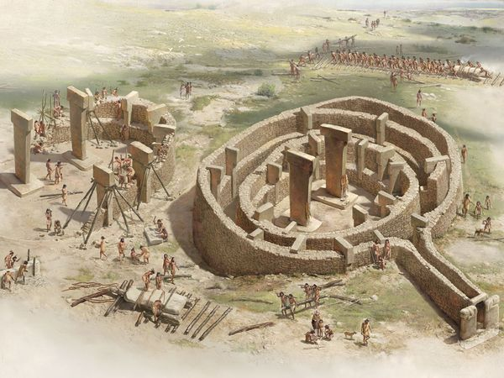
Empire State Building, 1930
Amiens Cathedral
1220
Great Pyramid of Giza, 2540 BC
Göbekli Tepe, 9th millennium BC

Slide 5
A Social Scale
Social scale (people) | Polity Types | Time (kya)
10s | Foraging bands | 200
100s | Farming villages | 10
1,000s | Simple chiefdoms | 7.5
10,000s | Complex chiefdoms | 7
100,000s | Archaic states | 5
1,000,000s | Macrostates | 4.5
10,000,000s | Mega-empires | 2.5
100,000,000s | Large nation-states | 0.2

Slide 6
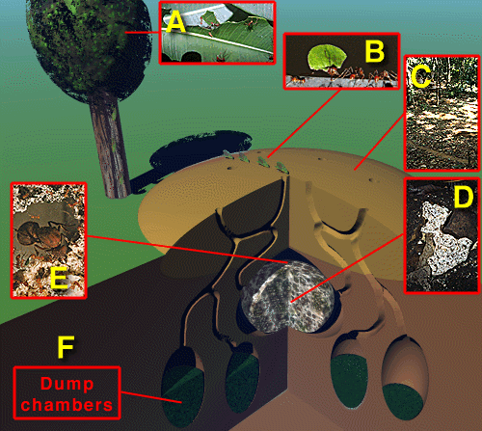
Social scale of a leaf cutter ant colony: 1,000,000s

Slide 7
A Social Scale
Social scale (people) | Polity Types | Time (kya)
10s | Foraging bands | 200
100s | Farming villages | 10
1,000s | Simple chiefdoms | 7.5
10,000s | Complex chiefdoms | 7
100,000s | Archaic states | 5
1,000,000s | Macrostates | 4.5
10,000,000s | Mega-empires | 2.5
100,000,000s | Large nation-states | 0.2
Humans are champion cooperators – an “ultrasocial species”

Slide 8
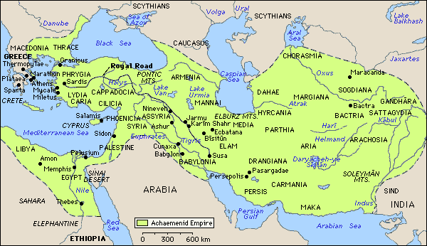
The Puzzle of Ultrasociality
Ultrasociality: extensive cooperation among very large numbers of genetically unrelated individuals
Ultrasociality was a key glue holding together historical mega-empires
But cooperation is fragile and is easily destroyed by “free-riding”
How did it evolve?
This is one of the unresolved Grand Questions of social science
Achaemenid Empire: 2.5 kya
Notes:
8

Slide 9
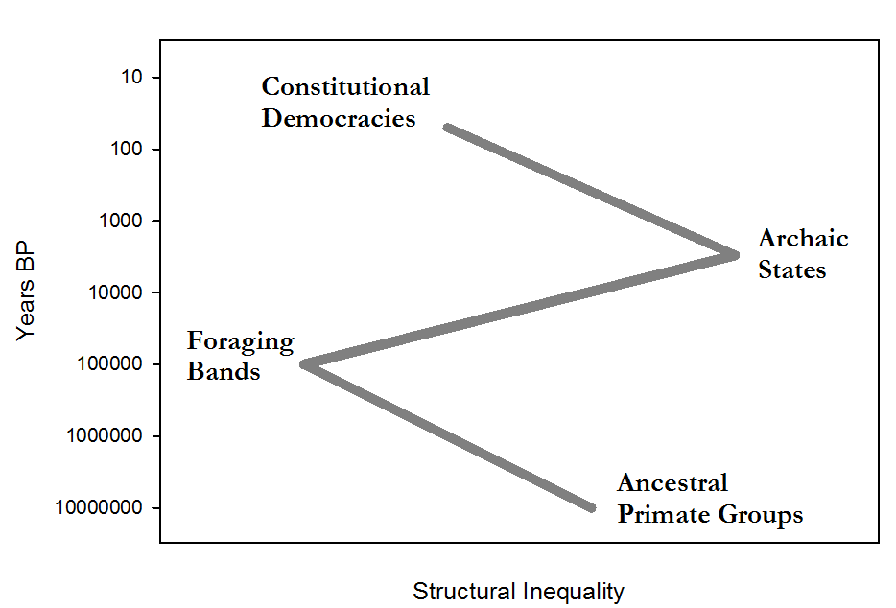
The Z-Curve of Human Inequality over the Long Term

Slide 10
Major Themes
Theory
Cultural Multilevel Selection (CMLS) explains the Z-curve of human inequality
Data
Seshat: Global History Databank quantifies trajectories of social complexity
Testing Theories
rival explanations of the evolution of human sacrifice

Slide 11
Evolution of Large-Scale Complex Societies: Many Theories
Resource base (agriculture)
Childe, White, Service, Diamond
Social differentiation and class structure
Marx, Engels, Patterson
Warfare and circumscription - Carneiro
Economics and trade, problem-solving and information processing, …
Cultural Multilevel Selection
Boyd, Richerson, D.S. Wilson, Bowles
Notes:
11

Slide 12
The Central Question: How can ultrasocial traits spread?
It is not a simple matter of accounting for their benefits for integration of large-scale societies
these institutions have significant costs
and historical record indicates that they repeatedly collapsed when societies scale down
need an evolutionary mechanism to explain the spread of such traits despite the costs
Notes:
12

Slide 13
Should rulers and elites be self-serving? Or should they act in prosocial ways that benefit governed populations?
Notes:
13

Slide 14
Small-scale societies
Egalitarian
Integrated by face-to-face interactions
Typical size – several hundred, at most a few thousand individuals
Social Brain theory: humans can maintain face-to-face cooperation in groups of up to 100-200 individuals
social channel capacity = 150 (“Dunbar number”)
How did evolution break through the threshold imposed by face-to-face interactions?

Slide 15
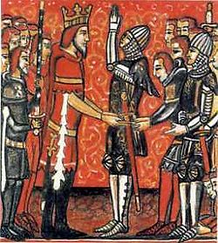
Hierarchical Organization
A binary relationship
lord-vassal
chiefly village/subordinate village
An elementary building block for constructing hierarchical social nets
Roland pledges his fealty to Charlemagne
Notes:
15

Slide 16
Adding hierarchical levels allows building social networks of unlimited size

Slide 17
Hierarchical social organization (chains of command)
allows to increase group size without increasing social channel capacity
enables political and administrative organizations (bureaucracies)
increases efficiency of military operations
Hierarchically organized large-scale societies win in competition with nonhierarchical (and “heterarchical”) societies
Notes:
17

Slide 18
The Dark Side of Hierarchy: inequality and despotism
Hierarchy inevitably leads to inegalitarian societies
“the Iron Law of Oligarchy” (Michels 1911)
A common route in human history:
temporary, ad hoc military leaders convert themselves into permanent, hereditary chiefs
use religion to legitimize inequality
Notes:
18

Slide 19
The First Turn (‘Zig’)
The Neolithic transition
agriculture, potential surplus, private property, and intensification of warfare
The rise of hierarchical societies: chiefdoms and archaic states
Appearance of extreme forms of inequality (‘despotism’):
deification of rulers
human sacrifice
slavery
unequal rights for commoners and elites
enormous differentials in power & wealth

Slide 20
Downside of Extreme Inequality
Inequality corrodes cooperation
between rulers and the ruled
but also within the elites
Hugely unequal societies are vulnerable
to internal revolution
to external conquest
As societies grew in scale the social costs of extreme inequity increased
“legitimation crisis of the early state”
Jürgen Habermas, Robert Bellah

Slide 21
A CMLS View of Inequality
Inequality serves powerful individuals (rulers and elites)
increases their genetic fitness!
But it undermines social cooperation
despotic societies are fragile and liable to collapse
Thus:
Inequity norms tend to increase within societies: inequality and despotism grow
Competition between societies weeds out despotic societies: prosocial and equity-promoting norms spread
Notes:
21

Slide 22
Axial Age (?)
Intensification of military intersocietal competition after 1000 BCE
iron weapons, cavalry, composite bows
Selection pressure for larger social size
“God is on the side of big battalions”
Inability of despotic archaic states to scale up
“legitimation crisis” (Habermas, Bellah)
Increased selection pressure for:
equity-promoting norms
constraints on rulers to act prosocially

Slide 23
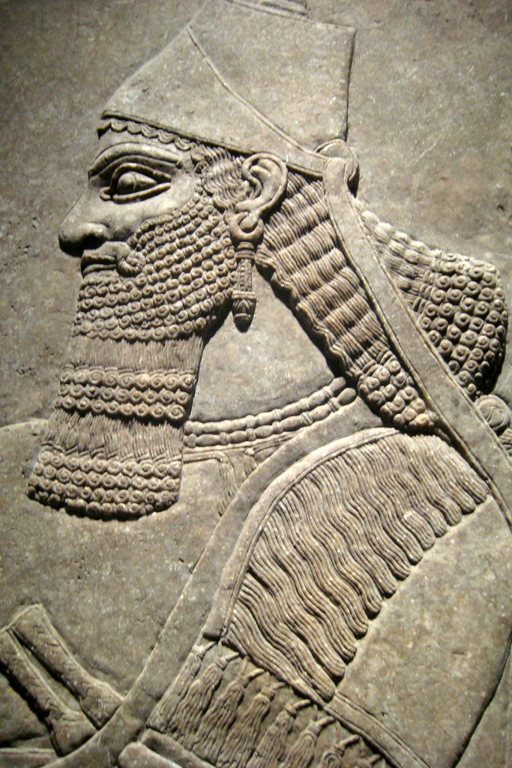
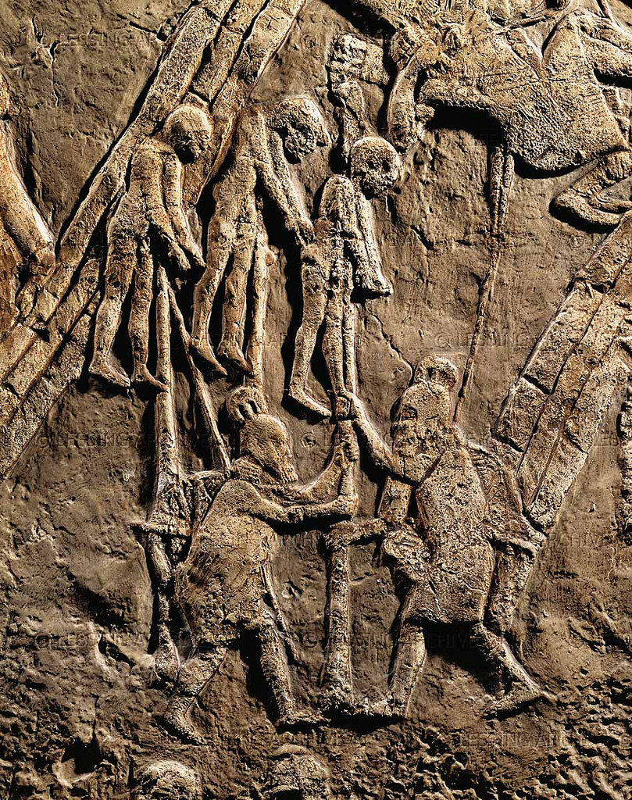
the rebellious nobles who had revolted against me and whose skins I had stripped off, I made into a trophy: some in the middle of the pile I left to decay; some on the top of the pile on stakes I impaled; some by the side of the pile I placed in order on stakes; many within view of my land I flayed; their skins on the walls I arranged; of the officers of the King's officer, rebels, the limbs I
cut off; Ahiyababa
to Nineveh I
flayed and
fastened his skin
to the wall.
I am Tiglath Pileser the powerful king; supreme King of Lashanan; King of the four regions; King of all Kings; Lord of Lords; the supreme; Monarch of Monarchs; the illustrious Chief ...

Slide 24
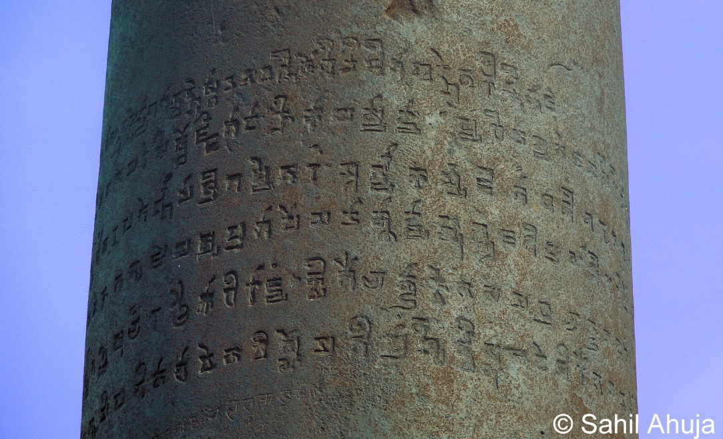
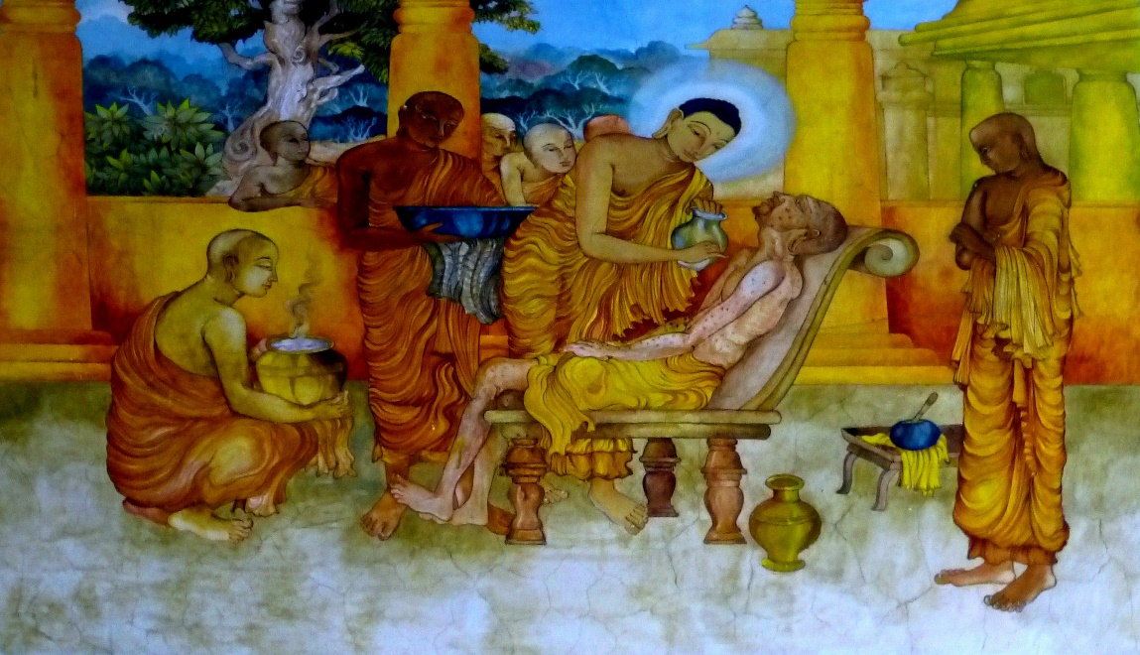
Ashoka Maurya (III c. BC)
I made provision for two types of medical treatment: medical treatment for humans and medical treatment for animals.
Wherever medical herbs suitable for humans or animals are not available, I have had them imported and grown.
Along roads I have had wells dug and trees planted for the benefit of humans and animals.
My magistrates are working among the people. The hearing of petitions and the administration of justice has been left to them so that they can do their duties confidently and fearlessly and so that they can work for the welfare, happiness and benefit of the people in the country.
From the Fourth Pillar Edict of Ashoka

Slide 25
The Second Turn (‘Zag’)
The Axial Age (c.800–200 BCE)
The rise of ‘world religions’
a “universally egalitarian ethic” (Bellah)
but religion can legitimate both equality and inequality
Spread of norms and institutions constraining rulers to promote the public good
Gradual disappearance of extreme forms of human inequality
abolition of human sacrifice, deification of rulers, slavery, etc
More recently: universal human rights and democratic forms of governance

Slide 26
The CMLS Predictions
It’s not really “Axial Age”
The prediction is about the relationship between inequality and social scale
The predicted relationship is nonlinear
inequality rising from small-scale to mid-scale societies
inequality falling from mid-scale to large-scale societies
The probability of appearance and spread of equity-promoting institutions should increase with social scale

Slide 27
Major Themes
Theory
Cultural Multilevel Selection (CMLS) explains the Z-curve of human inequality
Data
Seshat: Global History Databank quantifies trajectories of social complexity
Testing Theories
Rival explanations of the evolution of human sacrifice

Slide 28
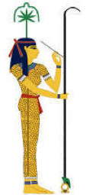
SESHAT: Global History Databank
The huge corpus of knowledge about past societies collectively possessed by academic historians is almost entirely in a form that is inaccessible to scientific analysis, stored in historians’ brains or scattered over heterogeneous notes and publications. The huge potential of this knowledge for testing theories about political and economic development has been largely untapped.
Project goals:
Build a web of facts about past societies, connected along spatial, temporal, and conceptual dimensions
Survey diversity in social evolutionary trajectories and identify general patterns
Test and reject theories of sociocultural evolution

Slide 29
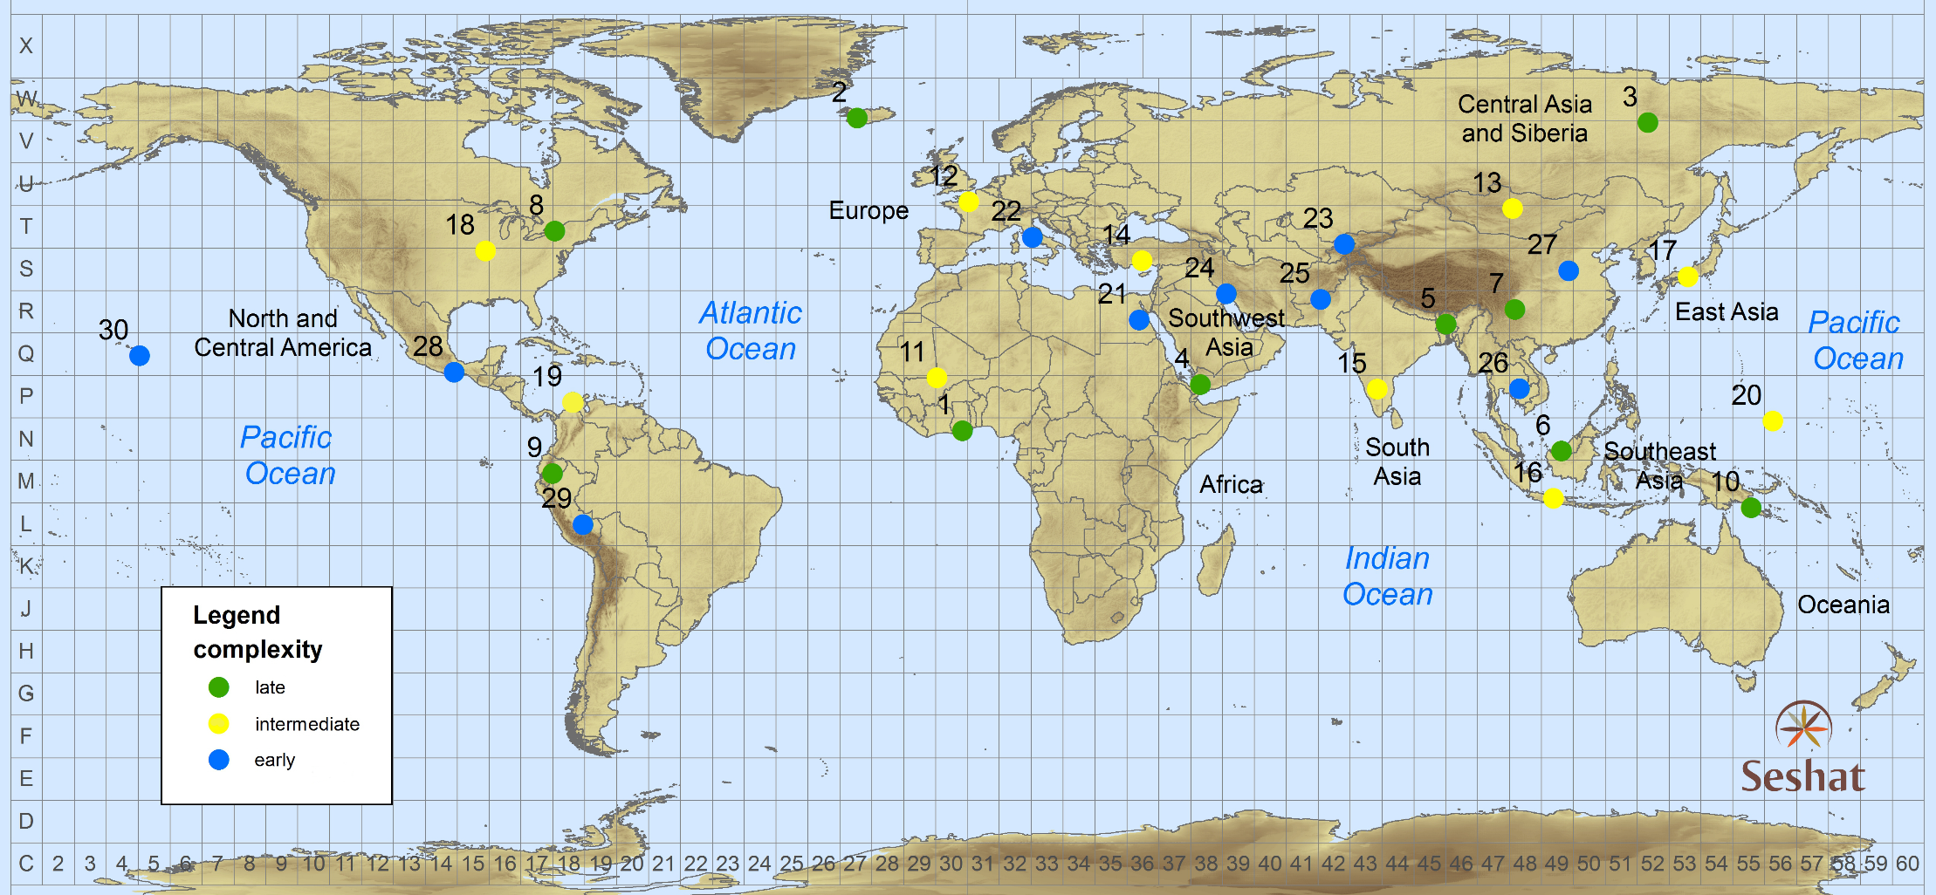
World Sample-30
Seshat: The Global
History Databank
Notes:
- sample societies from around the globe

Slide 30
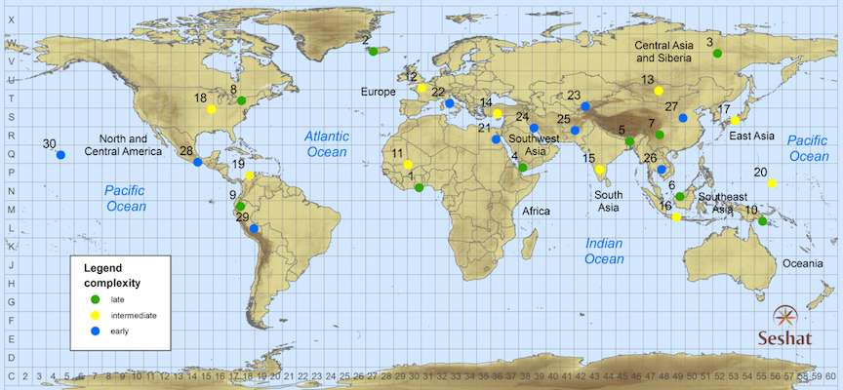
A Global Sample of the Historical and Archaeological Record
Polity | Start date | End date
Badarian | -4400 | -3801
Naqada IA-IIB | -3800 | -3551
Naqada IIC-D | -3550 | -3301
Dynasty 0 (Naqada IIIA-B) | -3300 | -3101
Dynasty I (Naqada IIIC) | -3100 | -2901
Dynasty II (Early Dynastic) | -2900 | -2651
Classic Old Kingdom | -2650 | -2351
Late Old Kingdom | -2350 | -2151
First Intermediate | -2150 | -2017
Middle Kingdom | -2016 | -1700
Second Intermediate | -1720 | -1567
New Kingdom-Thutmosid | -1550 | -1294
New Kingdom-Ramesside | -1293 | -1071
…
Ottoman Empire III | 1683 | 1839
At each sample point we code societies that occupied the area from the Neolithic to the Industrial Revolution. For example, Upper Egypt’s polities range from the Badarian to the Ottoman Empire.
Constructing a spatio-temporal dataset
Seshat: The Global
History Databank

Slide 31
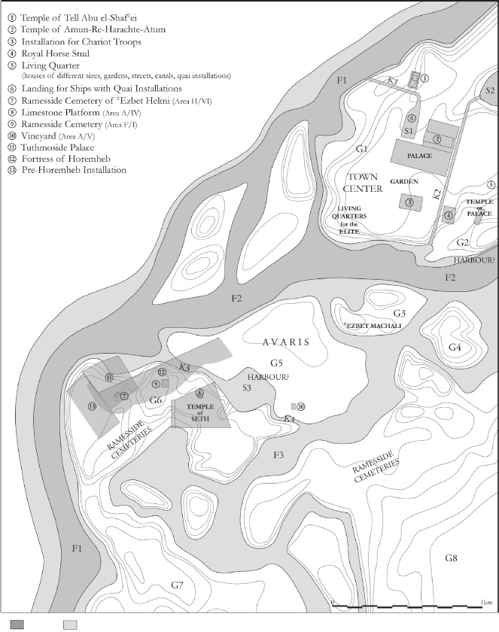
Example of a Seshat Record:
CapPop value for EgNKRam
♠ Population of the largest settlement ♣ {100,000; [250,000-300,000]} ♥
"the later Ramesside period marked a new era, when Pi-Ramesses, in the eastern Delta, became the main capital of the kingdom. The Austrian excavations are gradually revealing the huge dimensions and complexity of this metropolis of about 18km2 and 250,000–300,000 dwellers." [68]
Seshat Workshop on Egypt (Oxford, 2014): Bietak estimates that the population of Pi-Ramesses was around 250,000.
John Baines (Jan. 2017): can’t be more than 100k
Per-Ramesses topography - should be up-to-date hectare estimates in [69] →

Slide 32
Seshat Status, July 2018
34 NGAs
450 (quasi)polities
1500 variables
>200,000 Seshat records
5,000,000 triples (RDF)

Slide 33
Major Themes
Theory
Cultural Multilevel Selection (CMLS) explains the Z-curve of human inequality
Data
Seshat: Global History Databank quantifies trajectories of social complexity
Testing Theories
Two rival explanations of the evolution of human sacrifice

Slide 34
Quantifying Inequality
Structural inequality
deification of rulers
human sacrifice
slavery
unequal rights for commoners and elites
Reproductive inequality
leveling institutions (e.g., monogamy)
Health inequality
Archaeological proxies: burials
quantity and quality of grave goods
retainer sacrifice
labor costs of tomb construction

Slide 35
Quantifying Inequality
Structural inequality
deification of rulers
human sacrifice
slavery
unequal rights for commoners and elites
Reproductive inequality
leveling institutions (e.g., monogamy)
Health inequality
Archaeological proxies: burials
quantity and quality of grave goods
retainer sacrifice
labor costs of tomb construction

Slide 36
Human Sacrifice
Def: deliberate and ritualized killing of an individual to please or placate supernatural beings (such as gods, spirits, and ancestors)
HS type | n | World Regions
Funerary | 13 | Egypt, Mesopotamia, Anatolia, China, India, Europe, Andes, W Africa
Calendar | 12 | SE Asia, N America, Europe, Egypt, China, Mexico, Hawaii, Andes
Emergency | 6 | Egypt, Europe, Anatolia, Italy, W Africa
Construction | 4 | SE Asia, China, Mexico

Slide 37
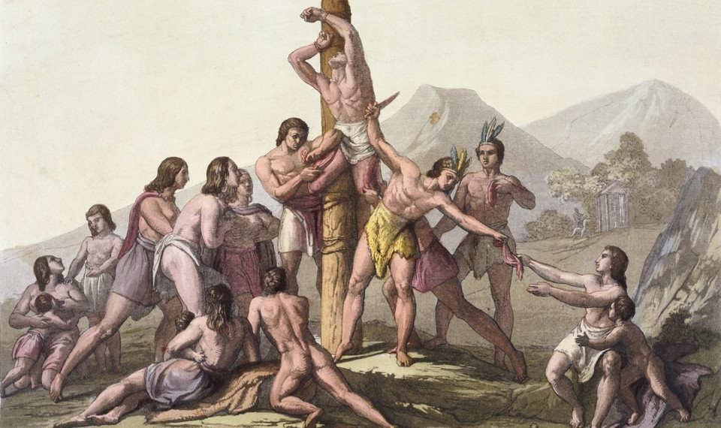
“the big-data approach to history has already provided a fascinating glimpse into the roots of social complexity”
Did Human Sacrifice Help People Form Complex Societies?
The debate over how well ritual killings maintained social order
LAURA SPINNEY February 2018

Slide 38
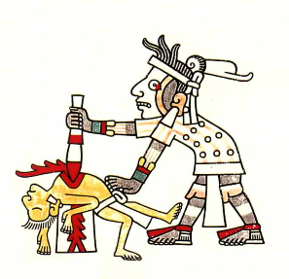
Red indicates NGAs where human sacrifice was practiced at some point in their history
The Rise and Fall of Human Sacrifice

Slide 39
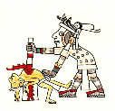
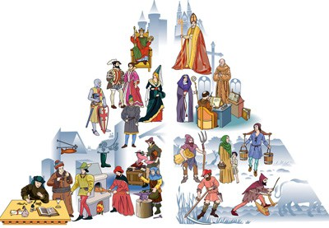
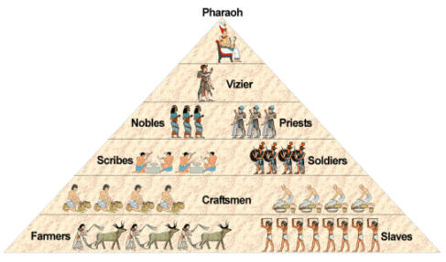
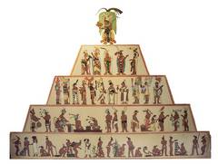
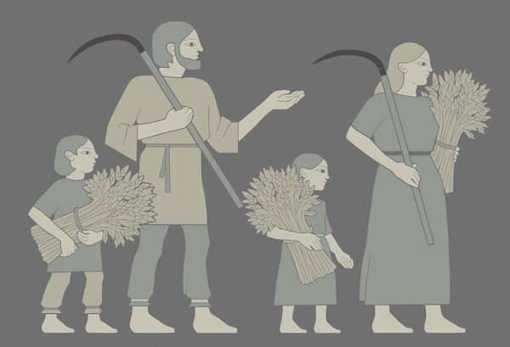
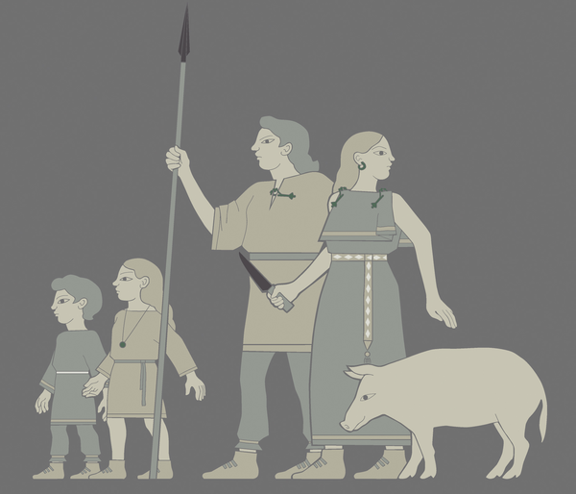
Cultural Multilevel Selection Theory predicts a nonlinear relationship: first rise, then decline of HS with social complexity
Absent or rare
Present
Absent
Human Sacrifice
Egalitarian
societies
Hierarchical class societies
Increasing Social Scale

Slide 40
Alternative Theories
Social Control Theory (Watts et al. 2016)
HS is “functional”: it promotes and stabilizes social stratification
Prediction: HS should increases as societies become more hierarchical
The “Escalator of Reason” (Pinker 2011)
superstitious killings, including HS, crumble under the scrutiny of more intellectually sophisticated populace
Prediction: HS should decrease as populations become more literate and intellectually sophisticated

Slide 41
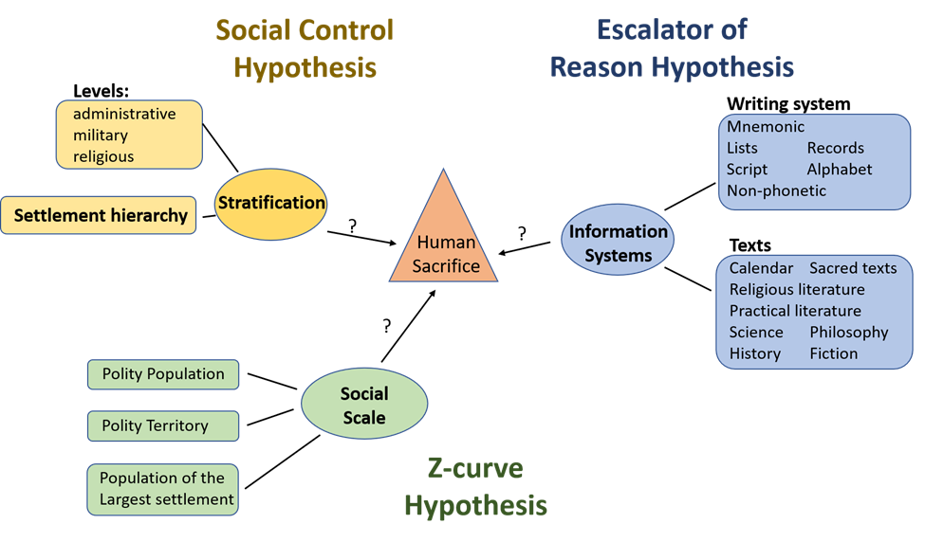

Slide 42
Regression Results
lm(formula = Y ~ ., family = binomial(link = "logit"), data=X)
Estimate Std. Error z value Pr(>|z|)
(Intercept) -6.64555 1.57371 -4.223 2.41e-05 ***
Lag1 4.80352 0.37998 12.642 < 2e-16 ***
Scale 1.87168 0.61434 3.047 0.002314 **
Scale.sq -0.17719 0.05202 -3.406 0.000658 ***
Strat -0.04979 0.19988 -0.249 0.803292
Info -0.07643 0.10728 -0.712 0.476186
---
Signif. codes: 0 ‘***’ 0.001 ‘**’ 0.01 ‘*’ 0.05 ‘.’ 0.1

Slide 43
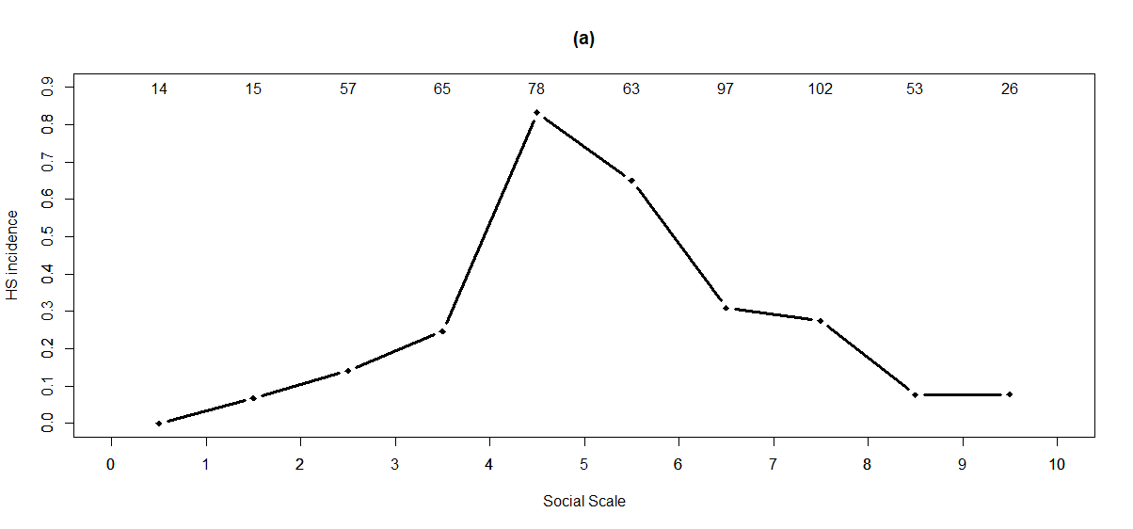
Nonlinear effect of complexity on HS

Slide 44
Large-scale societies
Our large-scale complex societies are based on ultrasociality
the capacity of humans to cooperate in huge groups of strangers
Cooperation is fragile
and so are large-scale societies
Inequality corrodes cooperation
it is one of the early warning signs of societal dysfunction

Slide 46
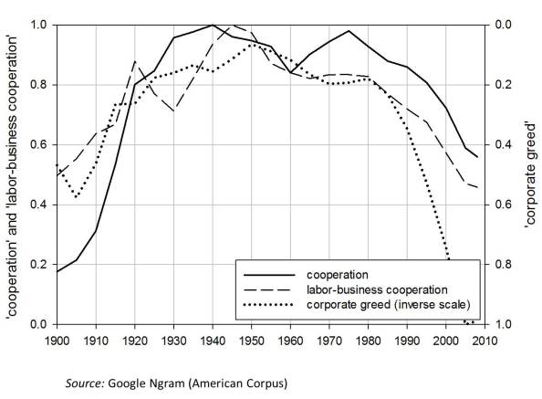

Slide 47
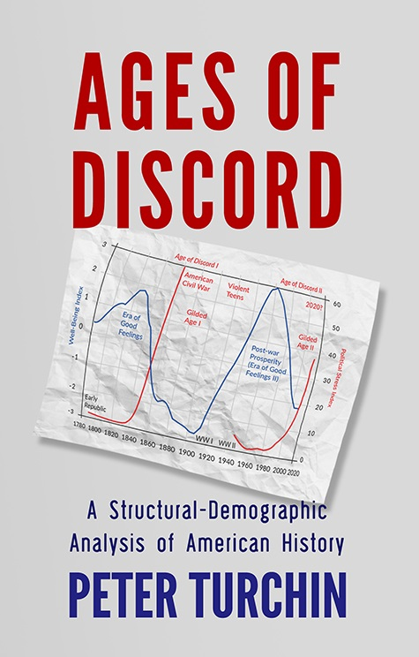

Slide 48
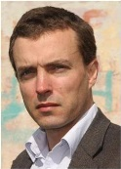
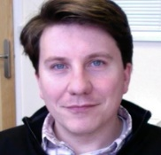
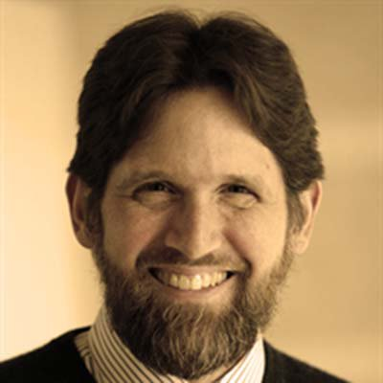
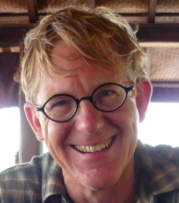
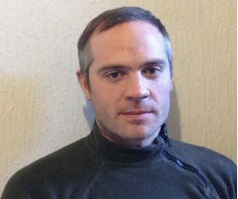
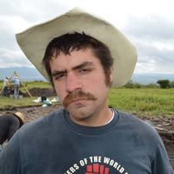
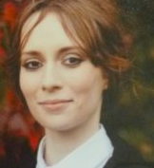
The Seshat Team
Directors
Domain Experts
Kevin Feeney Pieter Francois Harvey Whitehouse Peter Turchin
Project Manager
Research Assistants
Post-docs
Global History Databank

Slide 49
SESHAT: Global History Databank
Acknowledgments
Bernard Winograd
Jim Bennett
Tricoastal Foundation

